Slide 1

JEHOSHUA ACADEMY OF MARIKINA
Integrated
Responsive
Sustainable
WELCOME TO OUR
TLE CLASS!

Slide 2
JEHOSHUA ACADEMY OF MARIKINA
Integrated
Responsive
Sustainable
PRAYER

Slide 3
JEHOSHUA ACADEMY OF MARIKINA
Integrated
Responsive
Sustainable
CLASSROOM RULES

Slide 4



JEHOSHUA ACADEMY OF MARIKINA
Integrated
Responsive
Sustainable

Slide 5
JEHOSHUA ACADEMY OF MARIKINA
Integrated
Responsive
Sustainable
WEEK 1
DAY 1

Slide 6
JEHOSHUA ACADEMY OF MARIKINA
Integrated
Responsive
Sustainable
FAMILY AND CONSUMER SCIENCE (FCS)

Slide 7
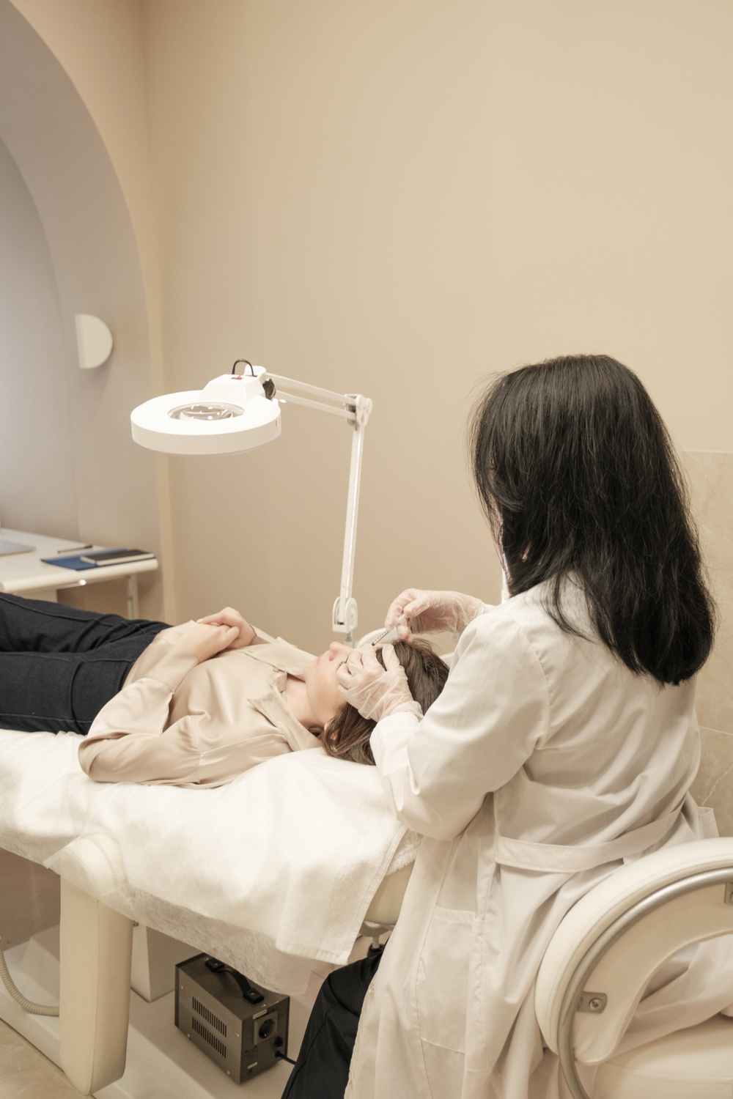
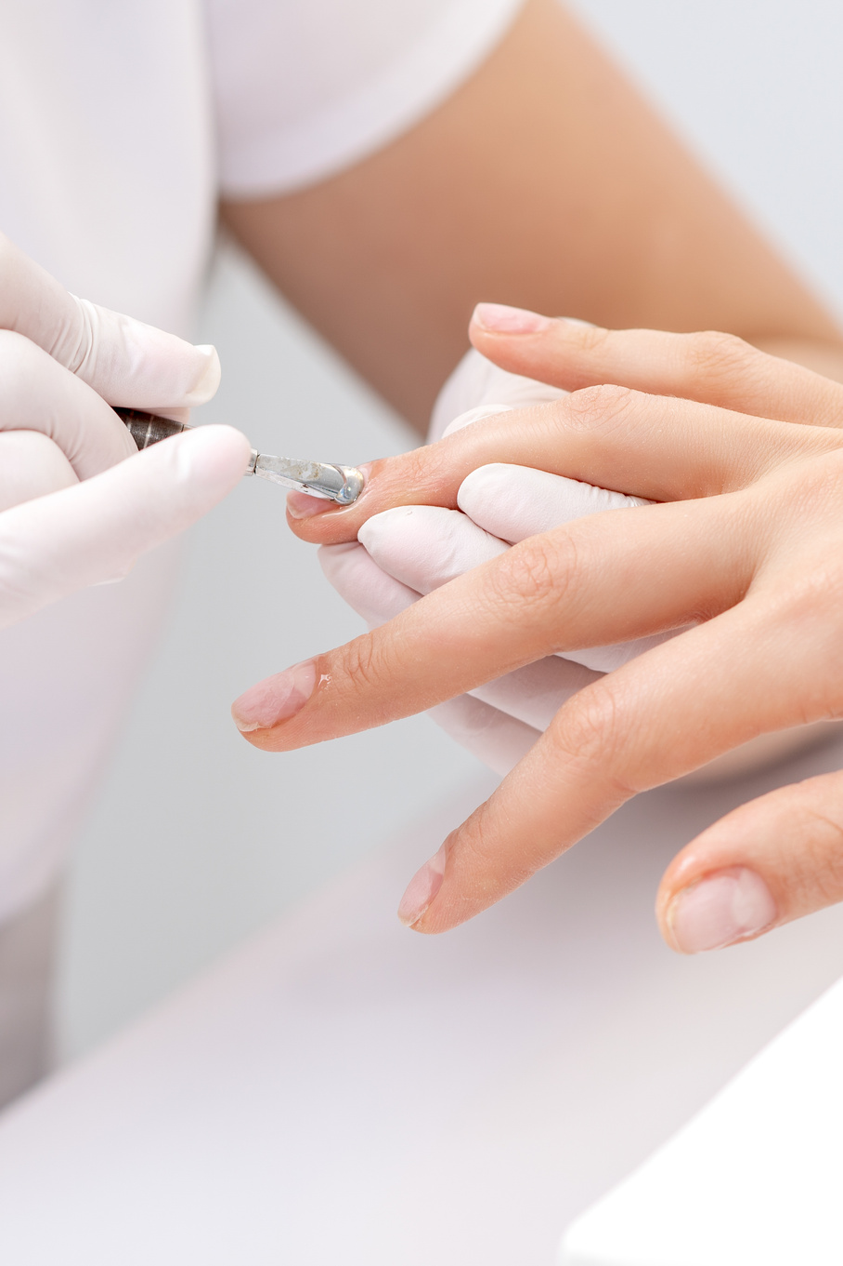
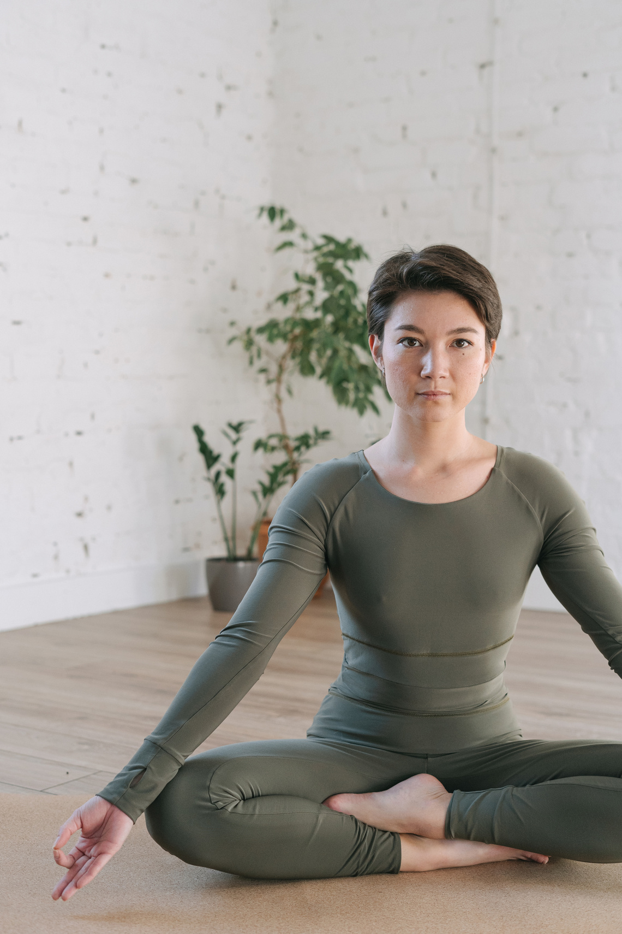
JEHOSHUA ACADEMY OF MARIKINA
Integrated
Responsive
Sustainable

Slide 8
JEHOSHUA ACADEMY OF MARIKINA
Integrated
Responsive
Sustainable
WEEK 1 DAY 1
Concepts of Beauty Care
and Wellness Service

Slide 9
JEHOSHUA ACADEMY OF MARIKINA
Integrated
Responsive
Sustainable
LEARNING OBJECTIVES:
a. define beauty care and wellness and give examples;
b. complete a beauty care and wellness assessment tool accurately and;
c. recognize and value ways to stay healthy and beautiful.

Slide 10
JEHOSHUA ACADEMY OF MARIKINA
Integrated
Responsive
Sustainable
Cosmetology, also known as Beauty Care, is all about the enhancement of appearance. It includes nail care, skincare and hair care.

Slide 11
JEHOSHUA ACADEMY OF MARIKINA
Integrated
Responsive
Sustainable
Wellness means achieving good health through a well-balanced condition of body and mind which enables the person to perform all his/her life’s role and functions normally.

Slide 12
JEHOSHUA ACADEMY OF MARIKINA
Integrated
Responsive
Sustainable
“Wellness, or being well must be more than just staying alive, instead we must live every moment of our lives fully by looking and feeling great by applying sensory awareness within ourselves to measure our capacity to live.”
-Judith Jackson, in her book entitled “The Magic of Well-Being

Slide 13
JEHOSHUA ACADEMY OF MARIKINA
Integrated
Responsive
Sustainable
“Beauty is in the eye of the beholder.”
-Molly Bawn

Slide 14

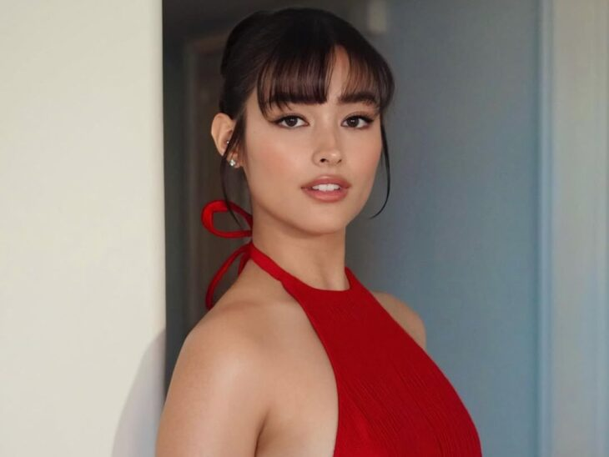
JEHOSHUA ACADEMY OF MARIKINA
Integrated
Responsive
Sustainable

Slide 15
JEHOSHUA ACADEMY OF MARIKINA
Integrated
Responsive
Sustainable
“Beauty is in the eye of the beholder.”
-Molly Bawn

Slide 16
JEHOSHUA ACADEMY OF MARIKINA
Integrated
Responsive
Sustainable
How to Stay Beautiful?

Slide 17
JEHOSHUA ACADEMY OF MARIKINA
Integrated
Responsive
Sustainable
1. Know yourself by looking at the mirror and appreciate the true tone of your skin, your hair texture, the shape of your face and your body figure.
2. Embrace the transforming possibilities you can make on your hair and face.

Slide 18
JEHOSHUA ACADEMY OF MARIKINA
Integrated
Responsive
Sustainable
3. Think and feel that you are beautiful, sexy and healthy.
4. Have self-confidence because being beautiful comes from within.
5. Keep your hair shiny and smooth.

Slide 19
JEHOSHUA ACADEMY OF MARIKINA
Integrated
Responsive
Sustainable
6. Have glowing skin.
7. Keep a smile on your face.

Slide 20
JEHOSHUA ACADEMY OF MARIKINA
Integrated
Responsive
Sustainable
How to Keep Oneself Well and Healthy?

Slide 21
JEHOSHUA ACADEMY OF MARIKINA
Integrated
Responsive
Sustainable
1. Eat nutritious, lighter, and healthier meals following the Recommended Dietary Allowance (RDA) each day considering age, height, weight and health status.

Slide 22
JEHOSHUA ACADEMY OF MARIKINA
Integrated
Responsive
Sustainable
2. Have regular exercise. Like: walking, simple stretching, and jogging.
3. Have enough rest and sleep
(at least 8 hours).

Slide 23
JEHOSHUA ACADEMY OF MARIKINA
Integrated
Responsive
Sustainable
4. Have some relaxation once in a while.
5. Practice personal hygiene.
6.Keep your hair clean, manageable, soft, shiny, and attractive.

Slide 24
JEHOSHUA ACADEMY OF MARIKINA
Integrated
Responsive
Sustainable
7. Drink at least 2-3 liters of water.
8. Consult your doctor and dentist at least every six (6) months.
9. Have a positive outlook in life.

Slide 25
JEHOSHUA ACADEMY OF MARIKINA
Integrated
Responsive
Sustainable
What beauty care services can we avail of in a beauty salon?

Slide 26
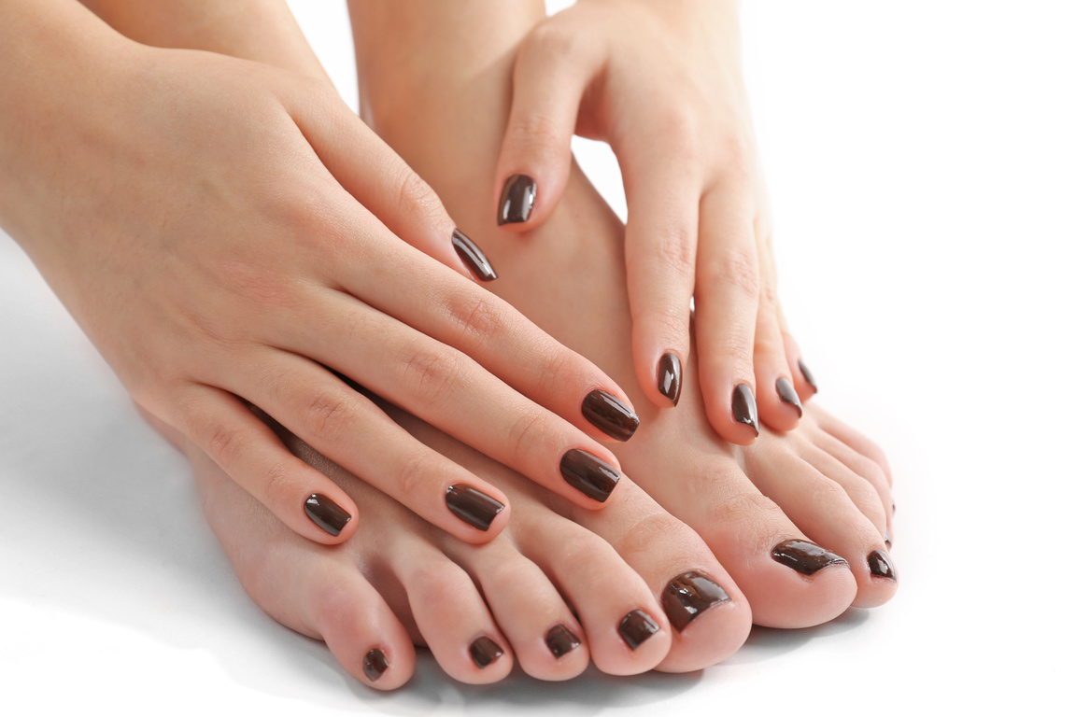
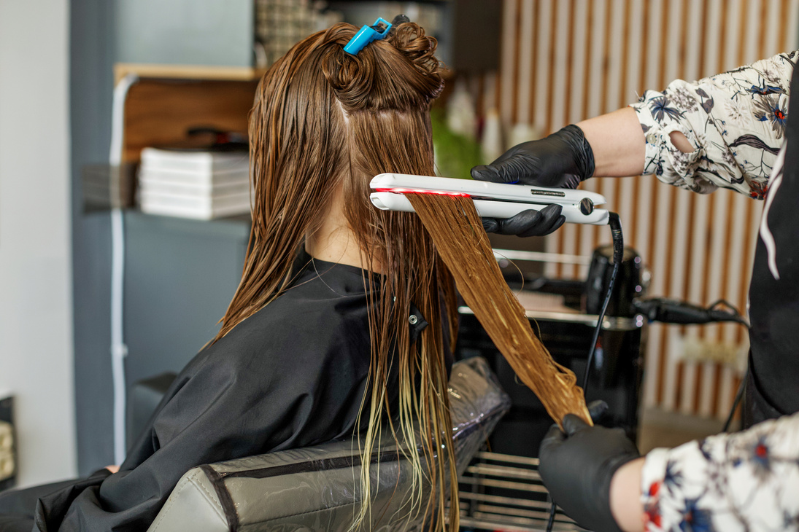
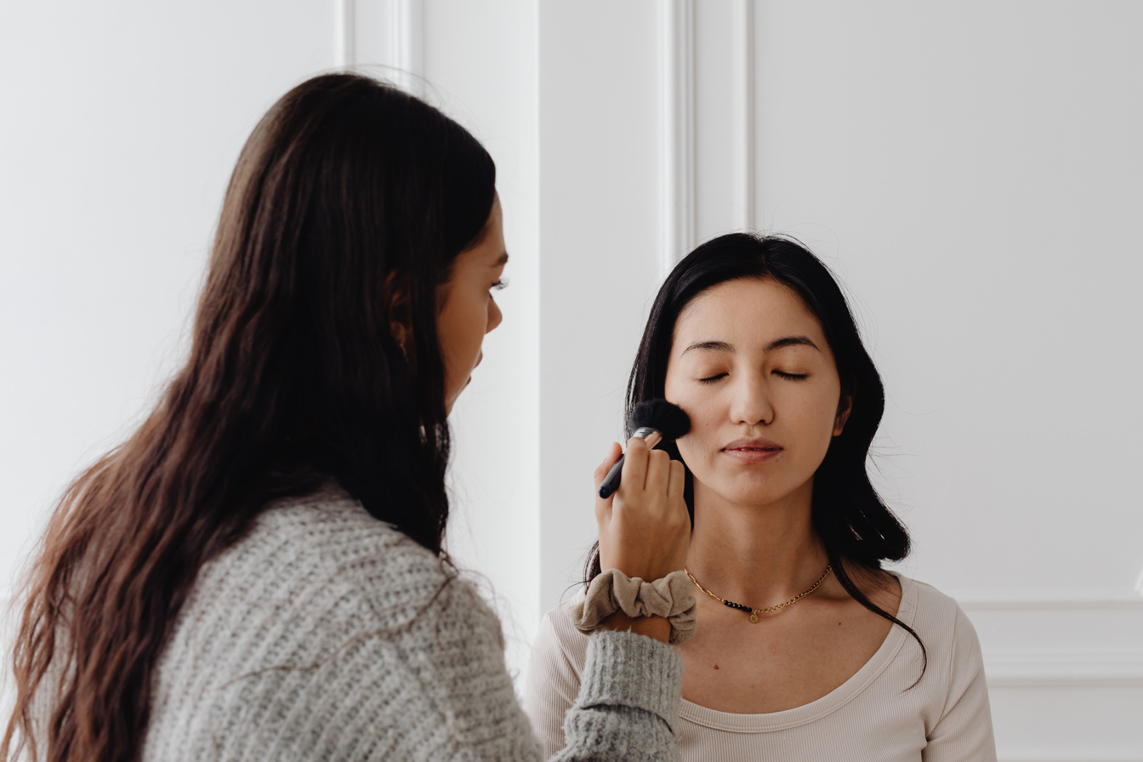
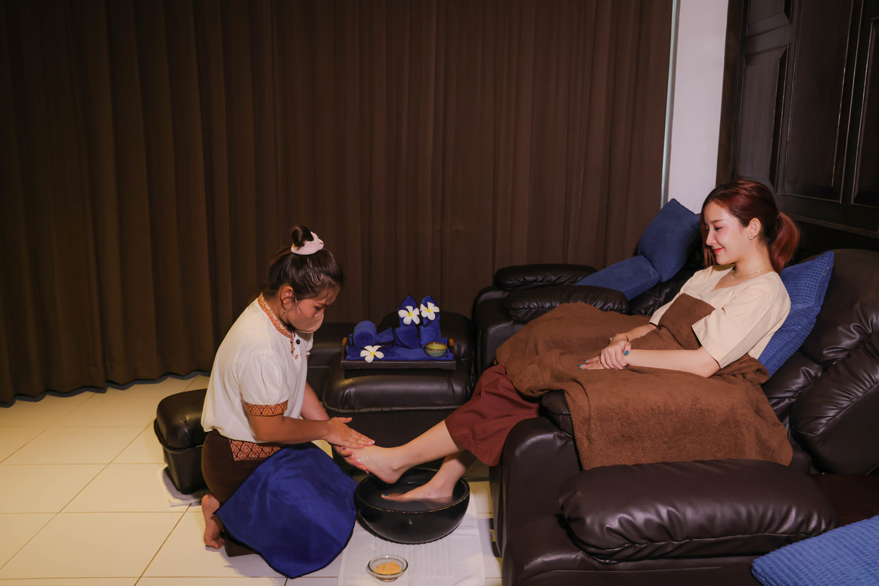
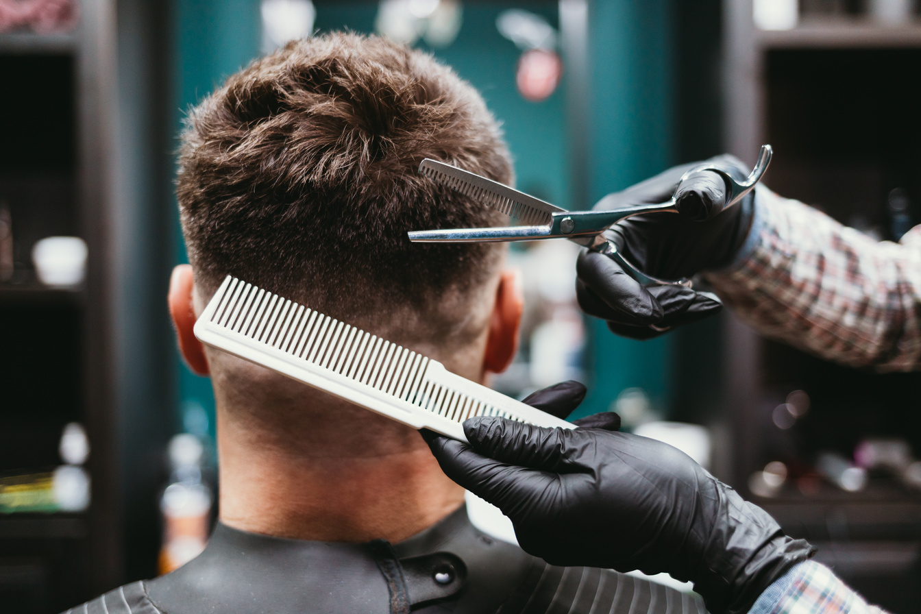
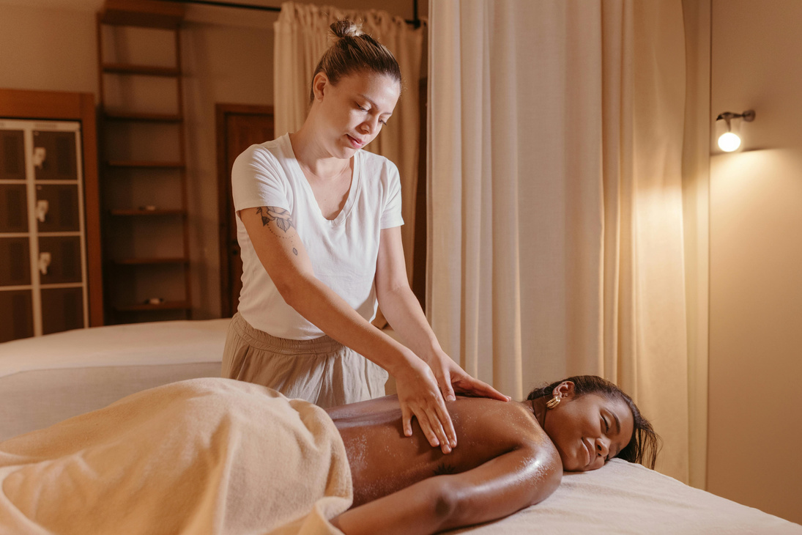
JEHOSHUA ACADEMY OF MARIKINA
Integrated
Responsive
Sustainable

Slide 27
JEHOSHUA ACADEMY OF MARIKINA
Integrated
Responsive
Sustainable
ACTIVITY 1
Beauty Care and Wellness Practices Assessment Tool

Slide 28
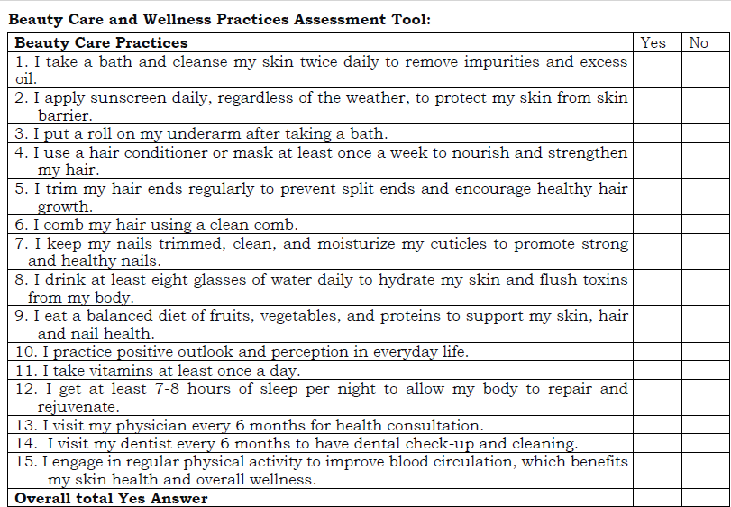
JEHOSHUA ACADEMY OF MARIKINA
Integrated
Responsive
Sustainable

Slide 29

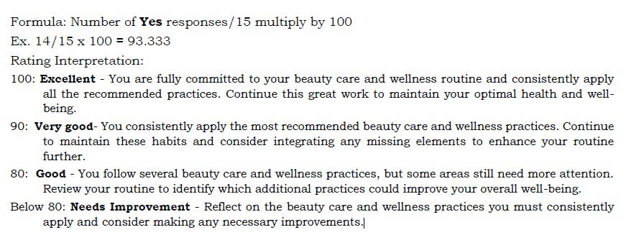
JEHOSHUA ACADEMY OF MARIKINA
Integrated
Responsive
Sustainable

Slide 30
JEHOSHUA ACADEMY OF MARIKINA
Integrated
Responsive
Sustainable
What emotions did you feel while doing the activity?
How do your personal habits in skin, hair, and nail care affect your overall health and self-confidence?

Slide 31
JEHOSHUA ACADEMY OF MARIKINA
Integrated
Responsive
Sustainable
What realizations did you have after you finished your task?

Slide 32
JEHOSHUA ACADEMY OF MARIKINA
Integrated
Responsive
Sustainable
ASSIGNMENT

Slide 33
JEHOSHUA ACADEMY OF MARIKINA
Integrated
Responsive
Sustainable
THANK YOU FOR LISTENING!

Slide 34
JEHOSHUA ACADEMY OF MARIKINA
Integrated
Responsive
Sustainable
PRAYER

